Slide 1
Internet of Things ( IoT )

Slide 2
The Internet of things (IoT) is the network of physical devices, vehicles, home appliances and other items embedded with electronics, software, sensors, and connectivity which enables these objects to connect and exchange data .

Slide 3
The IoT allows objects to be sensed or controlled remotely across existing network infrastructure, creating opportunities for more direct integration of the physical world into computer-based systems, and resulting in improved efficiency, accuracy and economic benefit in addition to reduced human intervention.

Slide 4
What is the smart home ??!
Network interconnected
Highly automated
Light control
Security
Improve comfort

Slide 5
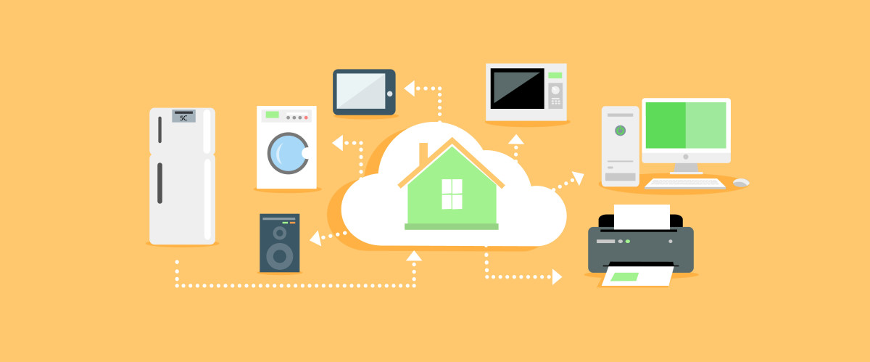
Implementation of IOT in HOME APPLIANCES

Slide 6
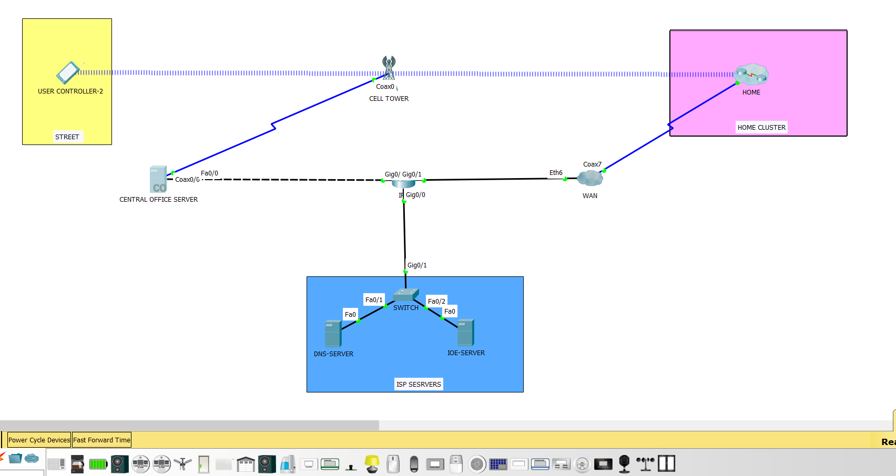
CISCO IMPLEMENTATION FOR MAKING SMART HOME

Slide 7
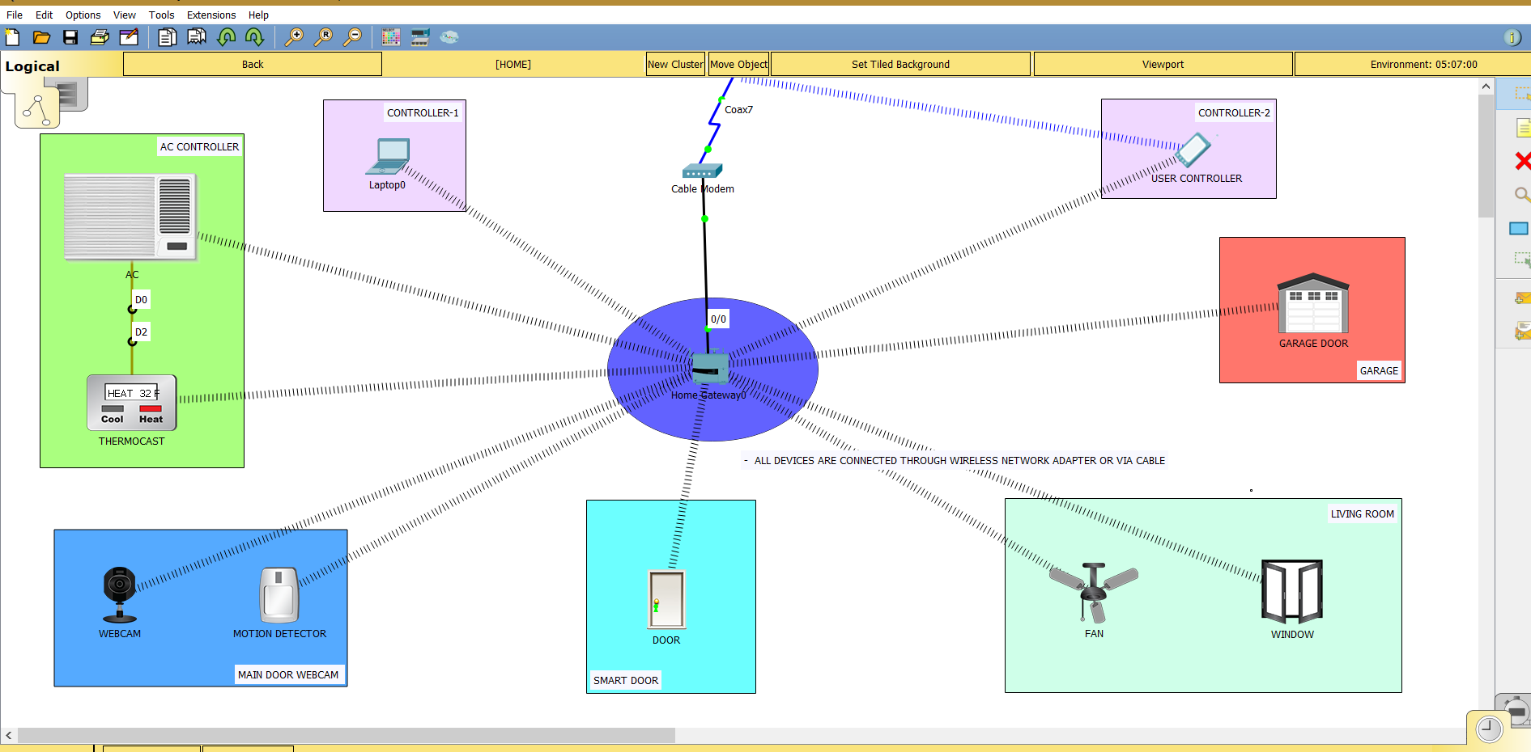

Slide 8
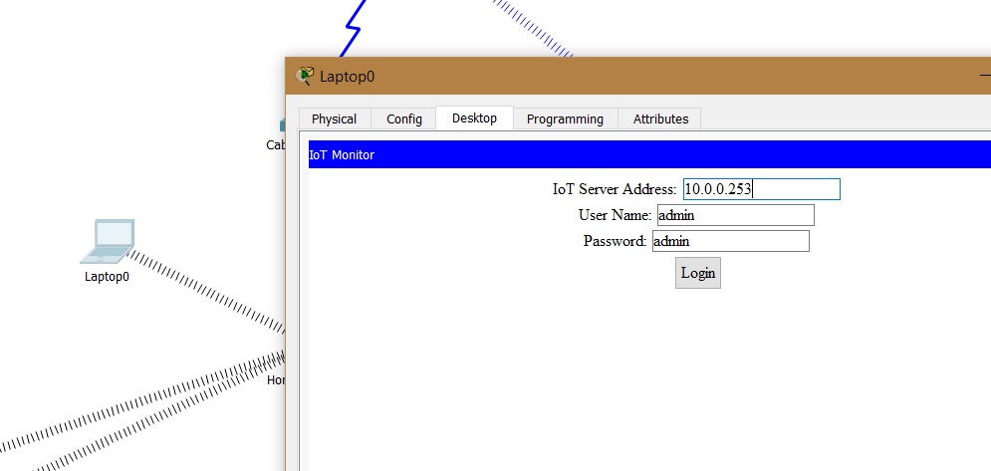

Slide 9
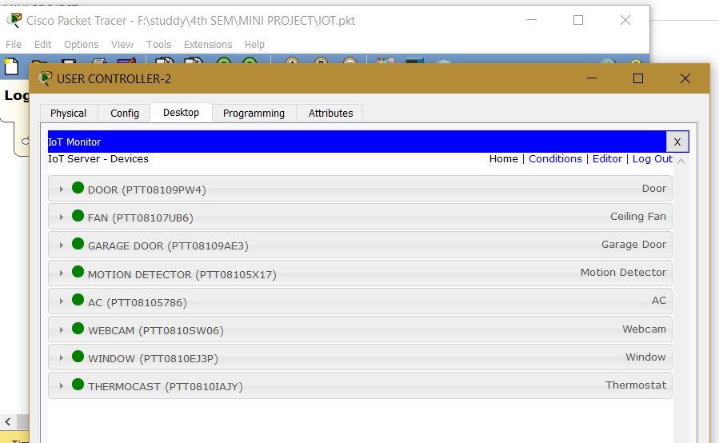

Slide 10
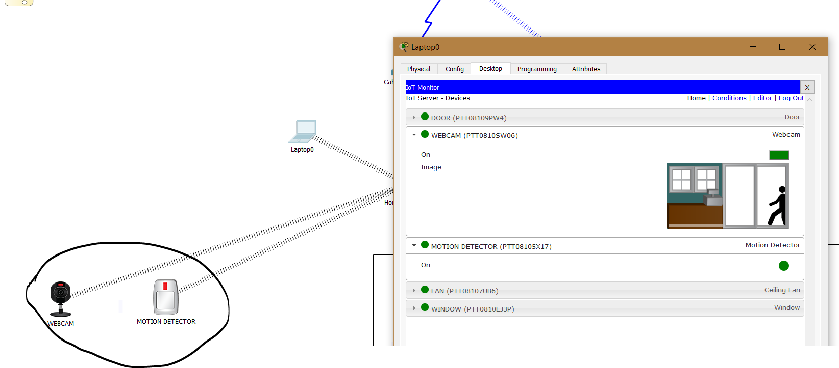

Slide 11
ADVANTAGES
One message is required to control the system
Fast and high efficiency
Great scalability
Provide flexibility
Increase manageability

Slide 12
disADVANTAGES
Short range monitoring
Low data speed
More skills required
Security risks

Slide 13
Future work
Future interest is to create framework with multiple applications sharing the same physical resources that will facilitate the rapid deployment and low cost of the emerging smart home.
Cognitive internet of things in smart home.

Slide 14
PROJECT WORK BY
Mungara Karan
Neha Nagar
Kanishka Pandey

